Slide 1

"From Beans to Data Coffee Sales Analysis in MySQL"

Slide 2
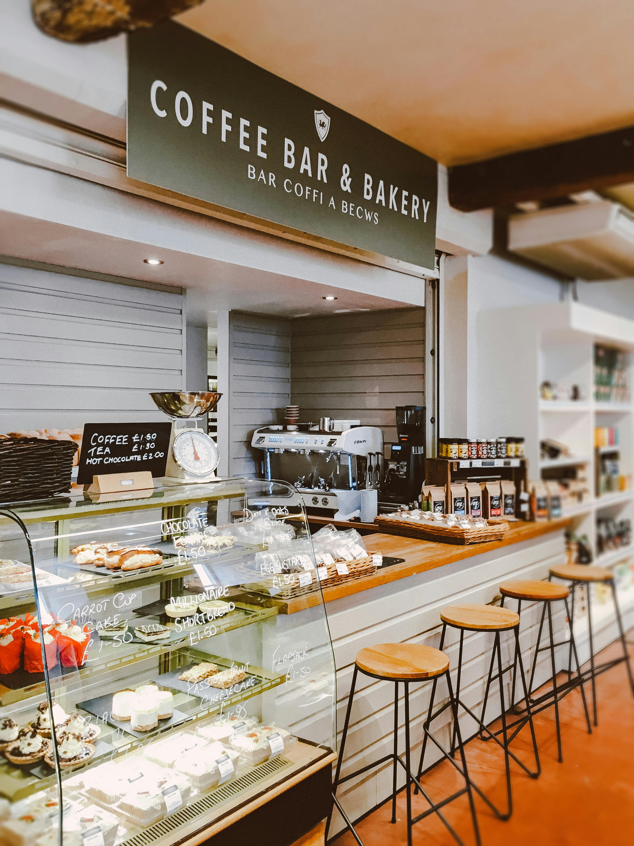
Project Objectives
Highlight the purpose of your project, such as:
Analyse coffee product sales trends.
Understand customer purchase behaviour by city.
Identify top-selling products and customer segments.
Generate insights for data-driven decision-making.

Slide 3

Dataset Overview
Provide a brief description of your tables:
City: Contains information about cities (City ID, Names, Population , Estimated rent , City Rank).
Customers: Stores customer details (Customer ID , Customer Name, City ID).
Product: Details of coffee products (Product ID , Product Name, Price)
Sales: Transaction details (Sales ID , Sales Date, Product ID , Customer ID, Total , Ratings)

Slide 4

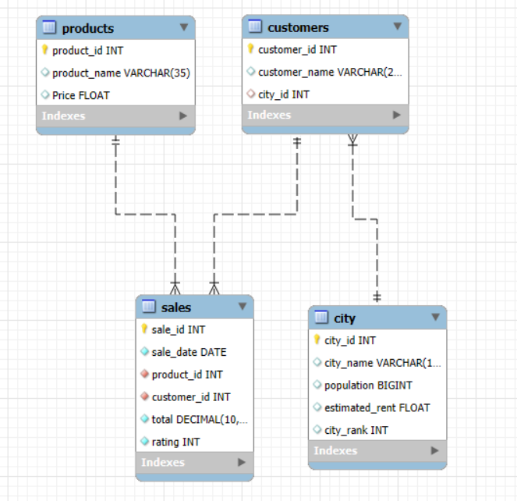
ER (Entity-Relationship) Diagram

Slide 5

Skills Demonstrated:
SQL Proficiency:
In writing complex queries, including JOIN, GROUP BY, ORDER BY, aggregate functions (SUM, AVG), and conditional logic (WHERE and HAVING).
Data Cleaning & Preparation:
Analyzed and organized raw coffee sales data for meaningful insights.
Business Insights Generation:
Translated raw data into actionable insights that could guide business decisions.
Analytical Thinking:
Identified patterns, trends, and correlations to understand customer behavior and product performance.

Slide 6

QUERY:
SELECT
products.product_name, SUM(sales.total / products.price) AS total_units_sold
FROM
coffe_sale.sales
JOIN
products ON sales.product_id = products.product_id
GROUP BY products.product_name
ORDER BY total_units_sold DESC;
How many units of
each coffee
product have been sold?

Slide 7

Product Name
Total_units_sold
Cold Brew Coffee Pack (6 Bottles) | 115
Instant Coffee Powder (100g) | 89
Coffee Beans (500g) | 89
Ground Espresso Coffee (250g) | 87
Tote Bag with Coffee Design | 80
Vanilla Coffee Syrup (250ml) | 58
Coffee Art Print | 37
Insulated Travel Mug | 32
Organic Green Coffee Beans (500g) | 31
Cold Brew Concentrate (500ml) | 28
Customizable Coffee Coaster Set | 22
Flavored Coffee Pods (Pack of 10) | 21
Coffee Drip Bags (10 Bags) | 20
Coffee-Themed T-Shirt | 14
Mocha Flavored Coffee Mix (200g) | 12
Glass Coffee Jar (500ml) | 11
Reusable Coffee Cup (Eco-friendly) | 9
Coffee Mug (Ceramic) | 8
Coffee Bean Storage Canister | 8
Coffee Recipe Book | 8
Coffee Plant Kit (DIY) | 7
Personalized Coffee Spoon | 7
Stainless Steel Tumbler | 6
Caramel Syrup (250ml) | 5
Coffee-Themed Notebook | 5
Coffee Gift Hamper | 0.28
Specialty Coffee Subscription | 0.17

Slide 8
2.Which city has the highest
total sales?
Query :
SELECT
city_name,
SUM(sales.total) AS total_sales
FROM
Coffe_sales.sales
JOIN
customers ON sales.customer_id = customer.customer_id
JOIN
city ON custpmers.city_id = city.city_id
GROUP BY
city.city_name
ORDER BY
total_sales DESC;
city_name | Total sale
Bangalore | 420710

Slide 9

QUERY:
SELECT
products.product_name, AVG(sales.rating) AS average_rating
FROM
coffe_sale.sales
JOIN
products ON sales.product_id = products.product_id
GROUP BY products.product_name
ORDER BY average_rating DESC;
3. What is the average
rating for each product?

Slide 10

Product_Name | Average_Rating
Specialty Coffee Subscription | 5
Caramel Syrup (250ml) | 5
Coffee-Themed Notebook | 4.8
Organic Green Coffee Beans (500g) | 4.6
Flavored Coffee Pods (Pack of 10) | 4.6
Coffee Plant Kit (DIY) | 4.6
Coffee Beans (500g) | 4.6
Coffee Drip Bags (10 Bags) | 4.6
Instant Coffee Powder (100g) | 4.5
Vanilla Coffee Syrup (250ml) | 4.5
Stainless Steel Tumbler | 4.5
Insulated Travel Mug | 4.5
Cold Brew Coffee Pack (6 Bottles) | 4.5
Coffee Art Print | 4.5
Tote Bag with Coffee Design | 4.5
Ground Espresso Coffee (250g) | 4.4
Mocha Flavored Coffee Mix (200g) | 4.4
Coffee Mug (Ceramic) | 4.4
Coffee-Themed T-Shirt | 4.4
Reusable Coffee Cup (Eco-friendly) | 4.3
Customizable Coffee Coaster Set | 4.3
Cold Brew Concentrate (500ml) | 4.3
Personalized Coffee Spoon | 4.3
Coffee Recipe Book | 4.3
Coffee Bean Storage Canister | 4.1
Glass Coffee Jar (500ml) | 4.1
Coffee Gift Hamper | 4

Slide 11
QUERY
SELECT customers.customer_name, SUM(sales.total) AS total_spent
FROM
coffe_sale.sales
JOIN
customers ON sales.customer_id = customers.customer_id
GROUP BY customers.customer_name
ORDER BY total_spent DESC;
4) Which customers
have made the highest purchases (total spend)?

Slide 12
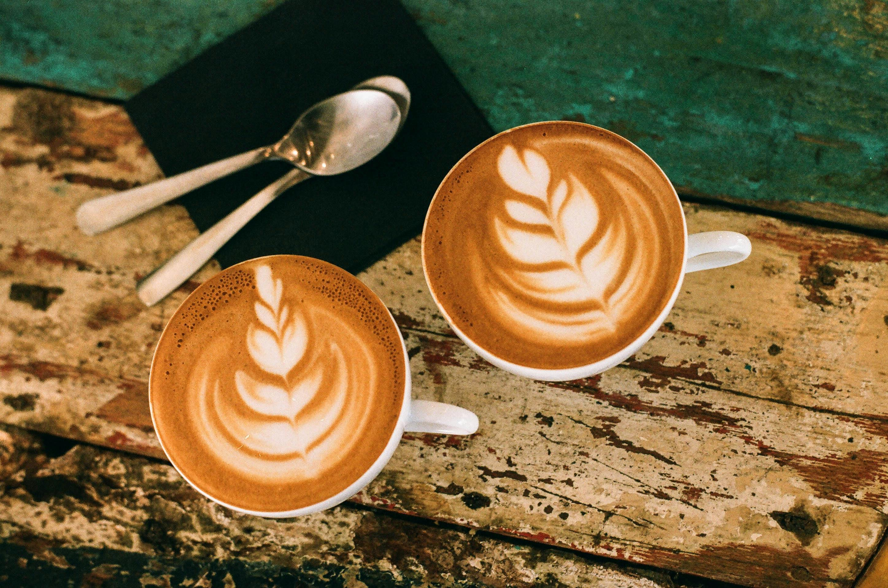
Customer_Name | Total_Spent
Aarav Agarwal | 24760
Ananya Malhotra | 24320
Aditya Sharma | 22950
Ananya Kumar | 22850
Arjun Rao | 21540
Aryan Malhotra | 20730
Ananya Gupta | 20640
Aditya Singh | 19220
Aditya Gupta | 19040
Arjun Agarwal | 18790
Aditi Gupta | 17590
Aditi Verma | 17570
Arjun Malhotra | 17340
Aryan Patel | 17260
Aditi Reddy | 17190
Aditya Malhotra | 15920
Arjun Pandey | 15350
Ananya Mehta | 15120
Aarav Pandey | 14910
Aditi Joshi | 14740
Aryan Desai | 14500
Arjun Reddy | 13640
Arjun Singh | 13640
Aryan Sharma | 1100

Slide 13

5) What are the top 5 best-selling products
(by revenue)?
QUERY -
SELECT
products.product_name, SUM(sales.total) AS total_revenue
FROM
coffe_sale.sales
JOIN
products ON sales.product_id = products.product_id
GROUP BY products.product_name
ORDER BY total_revenue DESC;

Slide 14

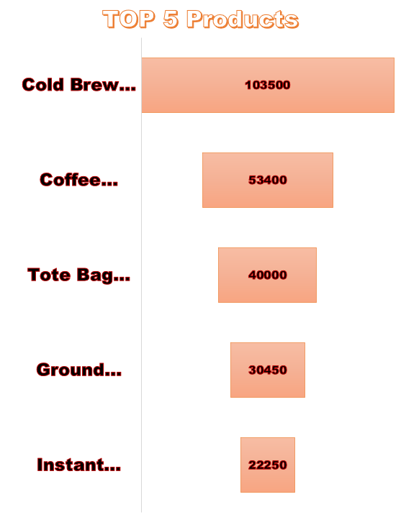
Product_Name | Total_Revenue
Cold Brew Coffee Pack (6 Bottles) | 103500
Coffee Beans (500g) | 53400
Tote Bag with Coffee Design | 40000
Ground Espresso Coffee (250g) | 30450
Instant Coffee Powder (100g) | 22250
Organic Green Coffee Beans (500g) | 21700
Insulated Travel Mug | 20800
Vanilla Coffee Syrup (250ml) | 18560
Flavored Coffee Pods (Pack of 10) | 15750
Cold Brew Concentrate (500ml) | 15400
Coffee Art Print | 14800
Coffee Drip Bags (10 Bags) | 9000
Coffee-Themed T-Shirt | 8400
Coffee Bean Storage Canister | 6400
Coffee Plant Kit (DIY) | 6300
Customizable Coffee Coaster Set | 5500
Mocha Flavored Coffee Mix (200g) | 5400
Coffee Recipe Book | 4800
Reusable Coffee Cup (Eco-friendly) | 4050
Glass Coffee Jar (500ml) | 3300
Stainless Steel Tumbler | 3000
Coffee Mug (Ceramic) | 2800
Caramel Syrup (250ml) | 1500
Coffee-Themed Notebook | 1500
Personalized Coffee Spoon | 1400
Coffee Gift Hamper | 500
Specialty Coffee Subscription | 250

Slide 15

6. What is the total sales per
city ranked by city rank?
Query:
SELECT
city.city_name, city.city_rank, SUM(sales.total) AS total_sales
FROM
coffe_sale.sales
JOIN
customers ON sales.customer_id = customers.customer_id
JOIN
city ON customers.city_id = city.city_id
GROUP BY city.city_name , city.city_rank
ORDER BY city.city_rank;
City Name | City Rank | Total Sales
Bangalore | 1 | 420710

Slide 16

Query:
SELECT
city.city_name, AVG(products.price) AS average_product_price
FROM
coffe_sale.sales
JOIN
customers ON sales.customer_id = customers.customer_id
JOIN
city ON customers.city_id = city.city_id
JOIN
products ON sales.product_id = products.product_id
GROUP BY city.city_name
ORDER BY average_product_price DESC;
7. What is the Average
Price of sold in each city ?
City Name | Average Product Price
Bangalore | 521.9

Slide 17
Product Name | Total Ratings | Average Rating
Specialty Coffee Subscription | 1 | 5
Caramel Syrup (250ml) | 5 | 5
Coffee-Themed Notebook | 5 | 4.8
Organic Green Coffee Beans (500g) | 31 | 4.6
Flavored Coffee Pods (Pack of 10) | 21 | 4.6
Coffee Plant Kit (DIY) | 7 | 4.6
Coffee Beans (500g) | 89 | 4.6
Coffee Drip Bags (10 Bags) | 20 | 4.6
Instant Coffee Powder (100g) | 89 | 4.5
Vanilla Coffee Syrup (250ml) | 58 | 4.5
Stainless Steel Tumbler | 6 | 4.5
Insulated Travel Mug | 32 | 4.5
Cold Brew Coffee Pack (6 Bottles) | 115 | 4.5
Coffee Art Print | 37 | 4.5
Tote Bag with Coffee Design | 80 | 4.5
Ground Espresso Coffee (250g) | 87 | 4.4
Mocha Flavored Coffee Mix (200g) | 12 | 4.4
Coffee Mug (Ceramic) | 8 | 4.4
Coffee-Themed T-Shirt | 14 | 4.4
Reusable Coffee Cup (Eco-friendly) | 9 | 4.3
Customizable Coffee Coaster Set | 22 | 4.3
Cold Brew Concentrate (500ml) | 28 | 4.3
Personalized Coffee Spoon | 7 | 4.3
Coffee Recipe Book | 8 | 4.3
Coffee Bean Storage Canister | 8 | 4.1
Glass Coffee Jar (500ml) | 11 | 4.1
Coffee Gift Hamper | 1 | 4
8) How many products have been rated by customers and their average rating ?

Slide 18
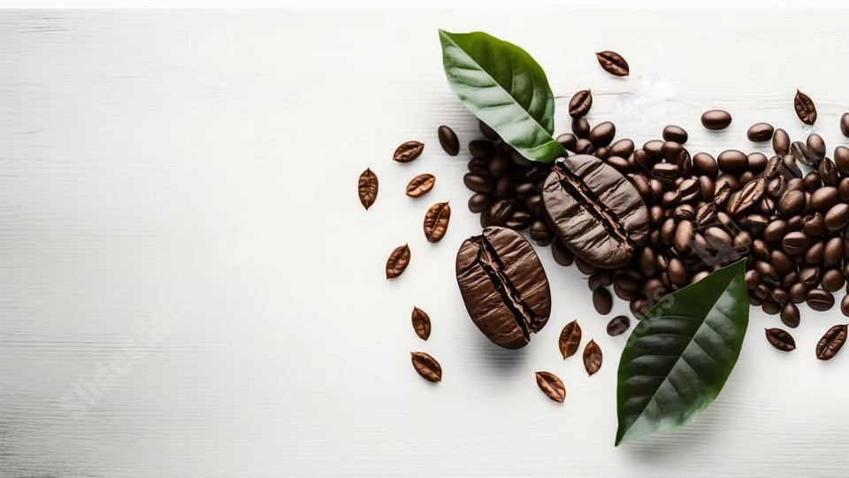
9. Which city has the highest population and what is its total sales?
Query: SELECT
city.city_name, city.population, SUM(sales.total) AS total_sales
FROM
coffe_sale.sales
JOIN
customers ON sales.customer_id = customers.customer_id
JOIN
city ON customers.city_id = city.city_id
GROUP BY city.city_name , city.population
ORDER BY city.population DESC;
City Name | Population | Total Sales
Bangalore | 12300000 | 420710

Slide 19
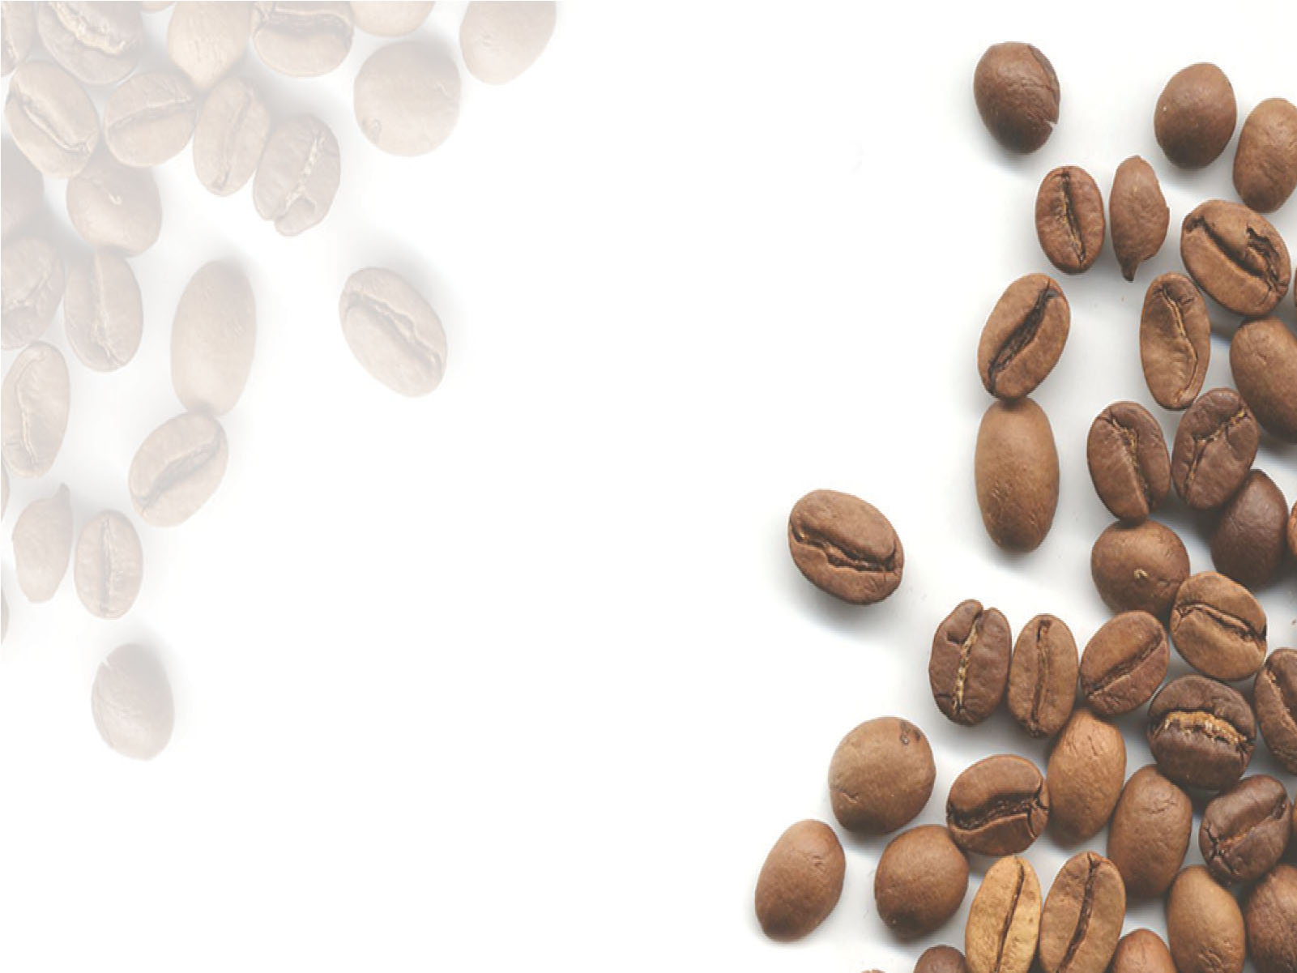
10. What is the Monthly sales trend for the entire company?
Query:
SELECT
DATE_FORMAT(sales.sale_date, '%Y-%m') AS month,
SUM(sales.total) AS total_sales
FROM
coffe_sale.sales
GROUP BY DATE_FORMAT(sales.sale_date, '%Y-%m')
ORDER BY month;
Month | Total_Sales
2023-01 | 15820
2023-02 | 15250
2023-03 | 18820
2023-04 | 12820
2023-05 | 15200
2023-06 | 19690
2023-07 | 13480
2023-08 | 15650
2023-09 | 46850
2023-10 | 33700
2023-11 | 35100
2023-12 | 24750
2024-01 | 34230
2024-02 | 30850
2024-03 | 35750
2024-04 | 5650
2024-05 | 9150
2024-06 | 7600
2024-07 | 10750
2024-08 | 6250
2024-09 | 13350

Slide 20

Impact:
This project demonstrates an ability to analyze complex datasets using MySQL, derive business insights, and provide actionable recommendations for improving sales, marketing, and operational strategies. The findings could directly contribute to better decision-making for coffee businesses or similar retail industries.

